Slide 1
DTNPL FM EMC Issue
’20.08.24
Lumir
KPLO DTNPL

Slide 2
목차
Issue 사항
EMC 검사 항목 Status
EMC 검사 항목 Status Matrix
시험 전 후 비교
결론

Slide 3
Issue 사항
상황 정리
  DTNPL FM EMC 시험 진행 (20.08.05 ~ 20.08.07)
    Bonding / Isolation Resistance
    Conducted Emission, Time Domain, Current & Voltage Ripple
    Conducted Emission ,Time Domain, Inrush Current
    Conducted Emission, Frequency Domain, Power Lines, 30Hz ~ 50MHz
    Conducted Emission Frequency Domain, Signal Line, 10kHz ~ 50MHz
    Radiated Emission, magnetic field, 30Hz ~ 100kHz
    Radiated Emission, Electric filed, 10kHz ~ 18GHz
  각 항목에 대한 세부항목 및 PASS / FAIL 여부는 뒷장 참조

Slide 4
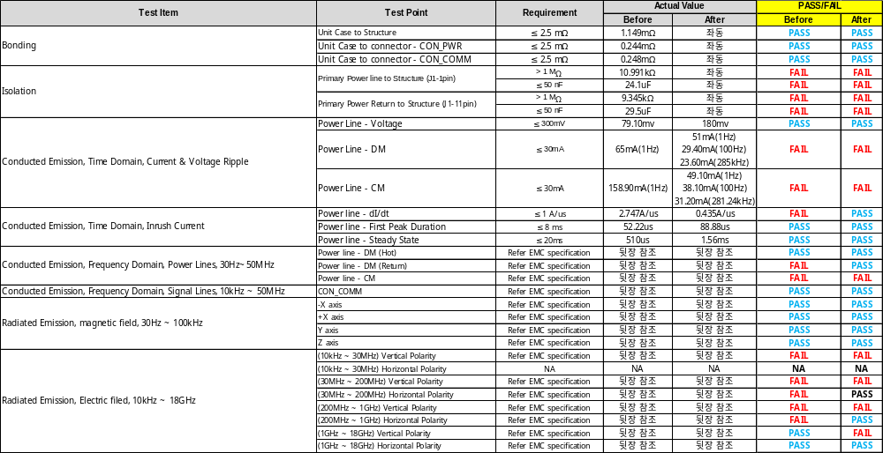
EMC 검사 항목 Status Matrix

Slide 5
시험 전 후 비교
시험 전 후 비교
  Bonding / Isolation Resistance
  Conducted Emission, Time Domain, Current & Voltage Ripple
  Conducted Emission ,Time Domain, Inrush Current
  Conducted Emission, Frequency Domain, Power Lines, 30Hz ~ 50MHz
  Conducted Emission Frequency Domain, Signal Line, 10kHz ~ 50MHz
  Radiated Emission, magnetic field, 30Hz ~ 100kHz
  Radiated Emission, Electric filed, 10kHz ~ 18GHz

Slide 6
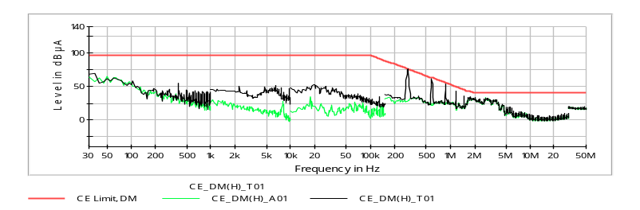
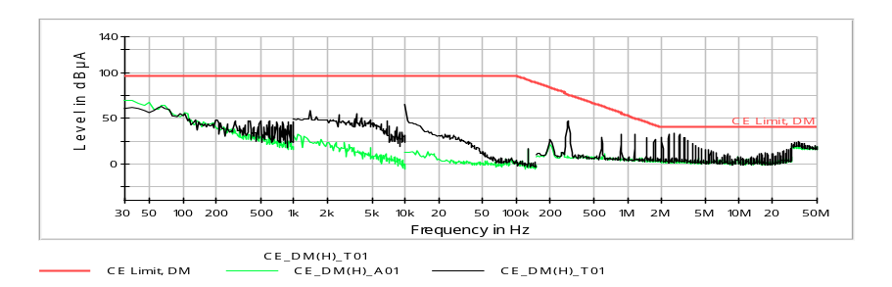
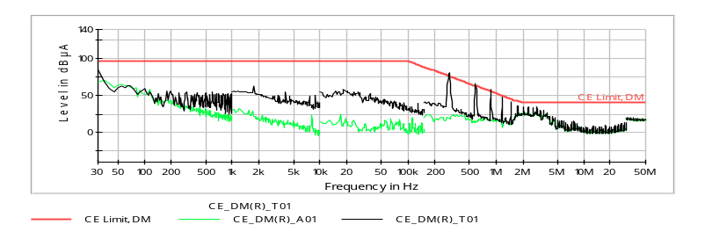
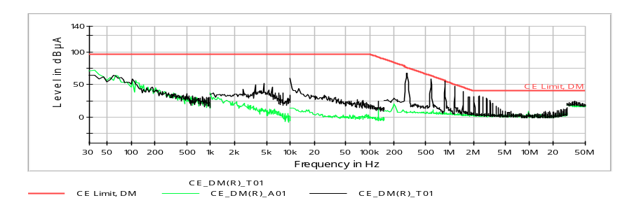
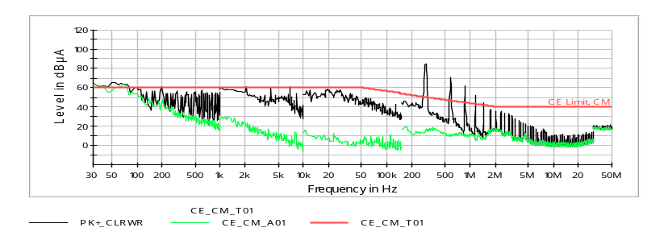
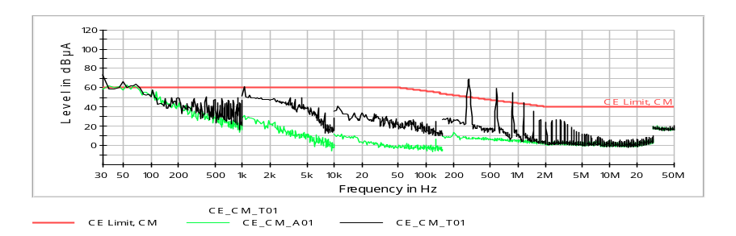
시험 전 후 비교
시험 전 후 비교
  Conducted Emission, Frequency Domain, Power Lines, 30Hz ~ 50MHz
DM_HOT
Before
After
DM_RTN
Before
After
CM
Before
After

Slide 7
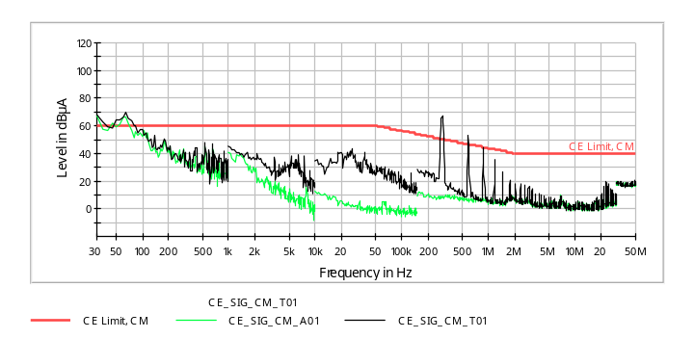
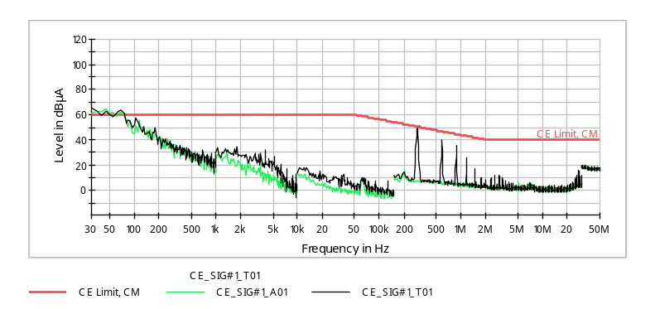
시험 전 후 비교
시험 전 후 비교
  Conducted Emission Frequency Domain, Signal Line, 10kHz ~ 50MHz
Before
After

Slide 8
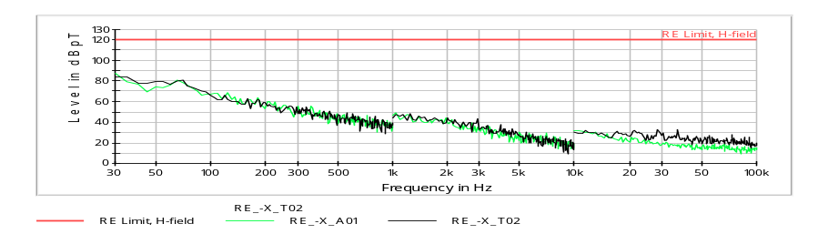
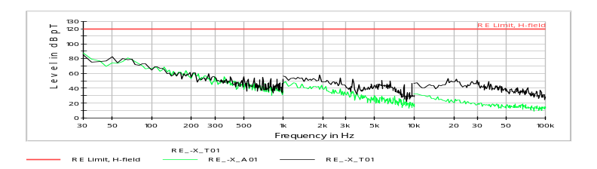
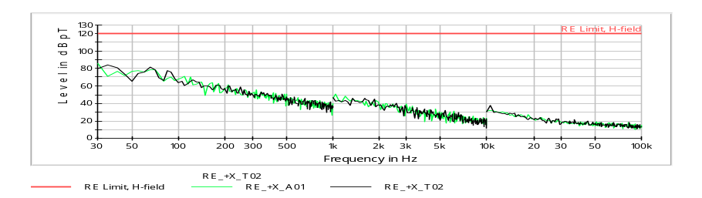
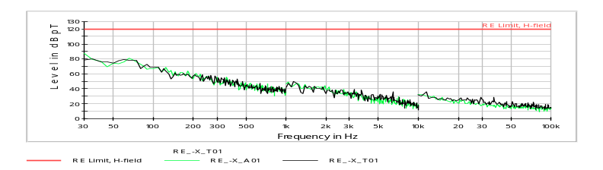
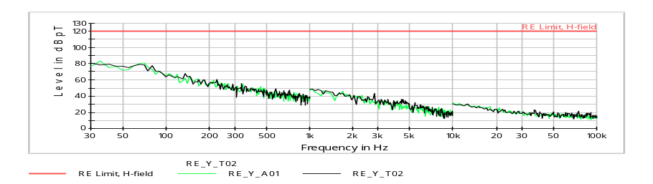
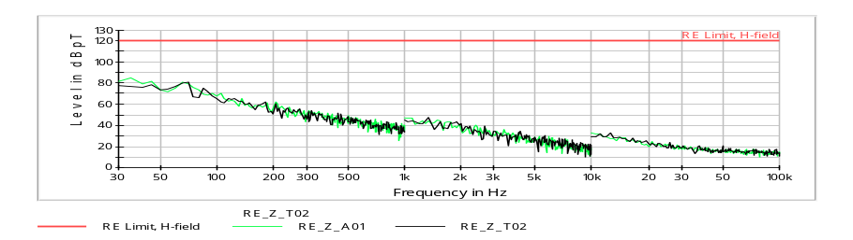
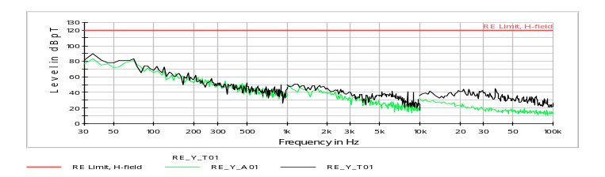
시험 전 후 비교
시험 전 후 비교
  Radiated Emission, magnetic field, 30Hz ~ 100kHz
Before
After
-X
Before
After
+X
Before
After
Y
Before
After
Z

Slide 9
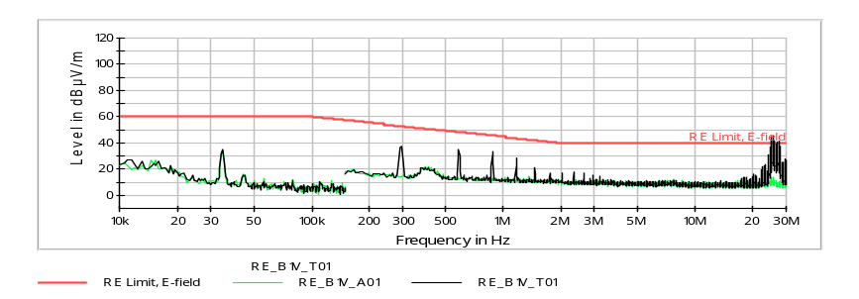
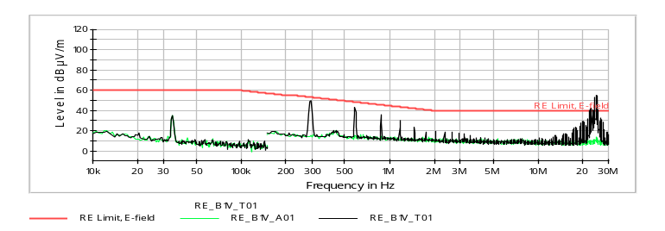
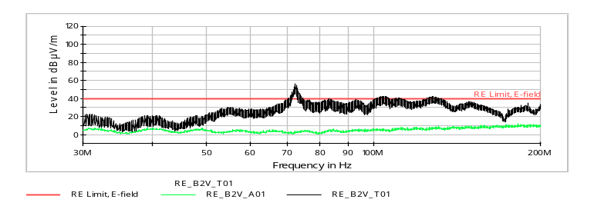
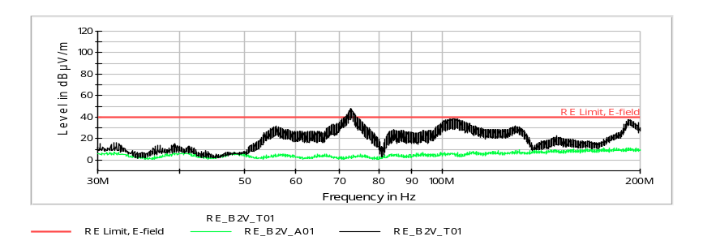
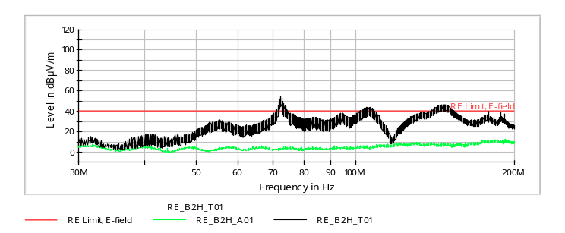
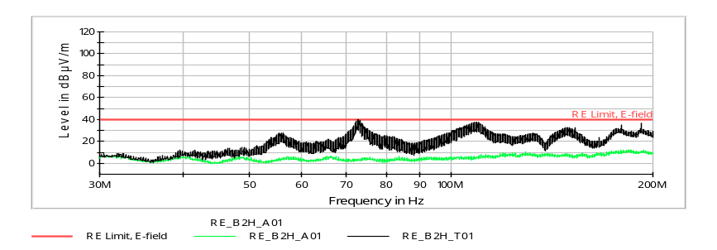
시험 전 후 비교
시험 전 후 비교
  Radiated Emission, Electric filed, 10kHz ~ 18GHz
10kHz ~ 30MHz (Vertical)
Before
After
30MHz ~ 200MHz (Vertical)
Before
After
30MHz ~ 200MHz (Horizontal)
Before
After

Slide 10
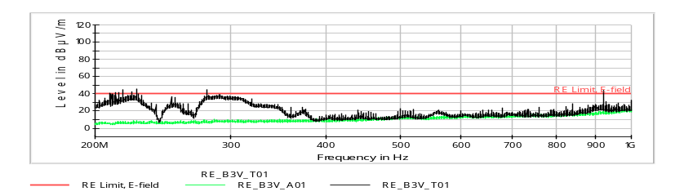
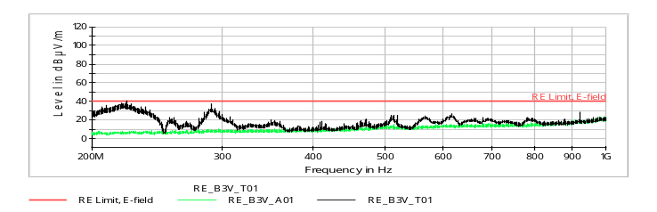
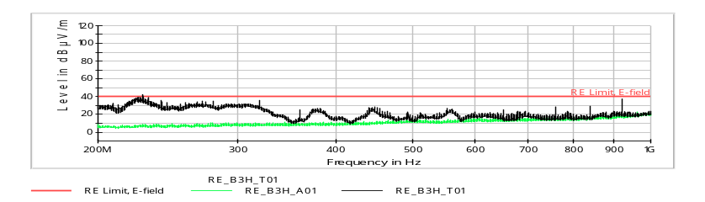
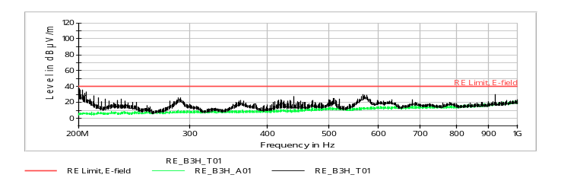
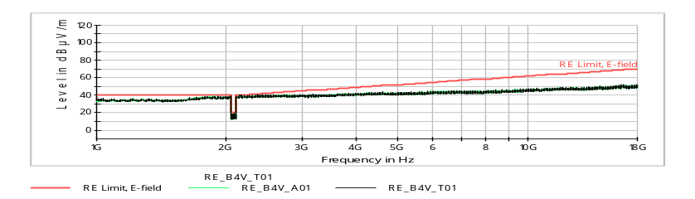
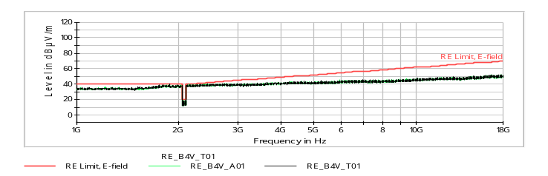
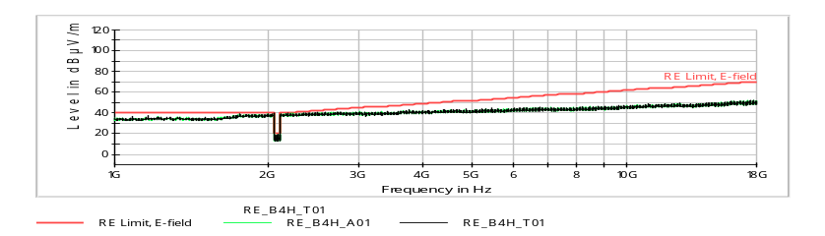

시험 전 후 비교
시험 전 후 비교 (계속)
  Radiated Emission, Electric filed, 10kHz ~ 18GHz
200MHz ~ 1GHz (Vertical)
Before
After
200MHz ~ 1GHz (Horizontal)
Before
After
1GHz ~ 18GHz (Vertical)
Before
After
1GHz ~ 18GHz (Horizontal)
Before
After

Slide 11
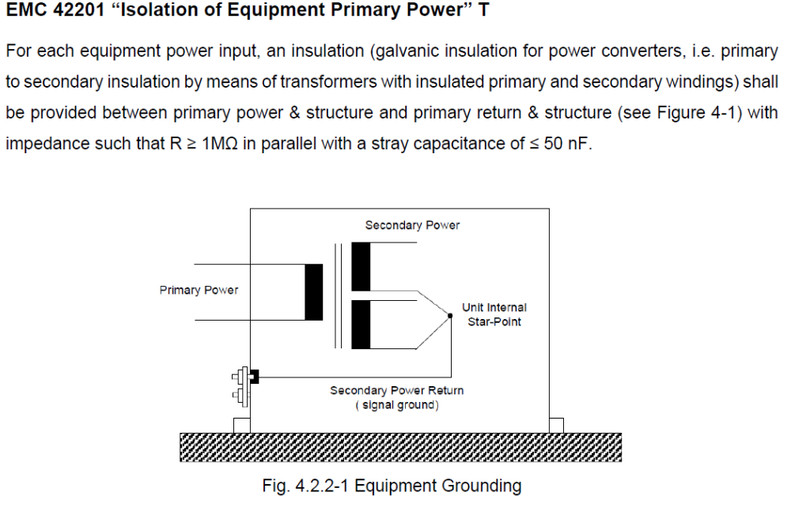
결론
결론
  아래와 같이 환경 변경하여 시험 진행 시 EMC 특성 좋아짐 확인
Before
After
1st – 2nd GND
Debug Con J03 으로 연결
1st – Chassie GND
외부 연결

